Slide 1


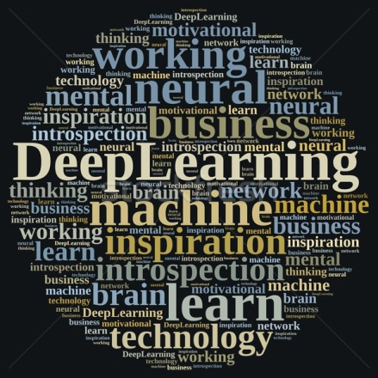
AI for Biomedical Signal/Image Processing 2019
AI for HEALTHCARE
Dr. V. Sowmya (Assistant Professor (Sr. Gr))
Dr. E. A. Gopalakrishnan (Assistant Professor (SG))
Dr. K. P. Soman (Professor & Head)
13-05-2019.

Slide 2

AI for Biomedical Signal/Image Processing 2019
WHY DEEP LEARNING FOR MEDICAL DIAGNOSIS?
Deep Learning is a Black Box, but Health Care Won’t Mind
New algorithms are able to diagnose disease as accurately as expert physicians
-Monique Brouillette , MIT Technology Review , April 2017.
DEEP LEARNING FOR MEDICAL IMAGE PROCESSING

Slide 3

AI for Biomedical Signal/Image Processing 2019
“Health: The Tricorder X price will be announced this year. There are companies who will build a medical device (called the “Tricorder” from Star Trek) that works with your phone, which takes your retina scan, your blood sample and you breath into it. It then analyses 54 biomarkers that will identify nearly any disease. It will be cheap, so in a few years everyone on this planet will have access to world class medical analysis, nearly for free. Goodbye, medical establishment. ”
Must read article on how our lives will change dramatically in 20 years by CEO of Mercedes

Slide 4
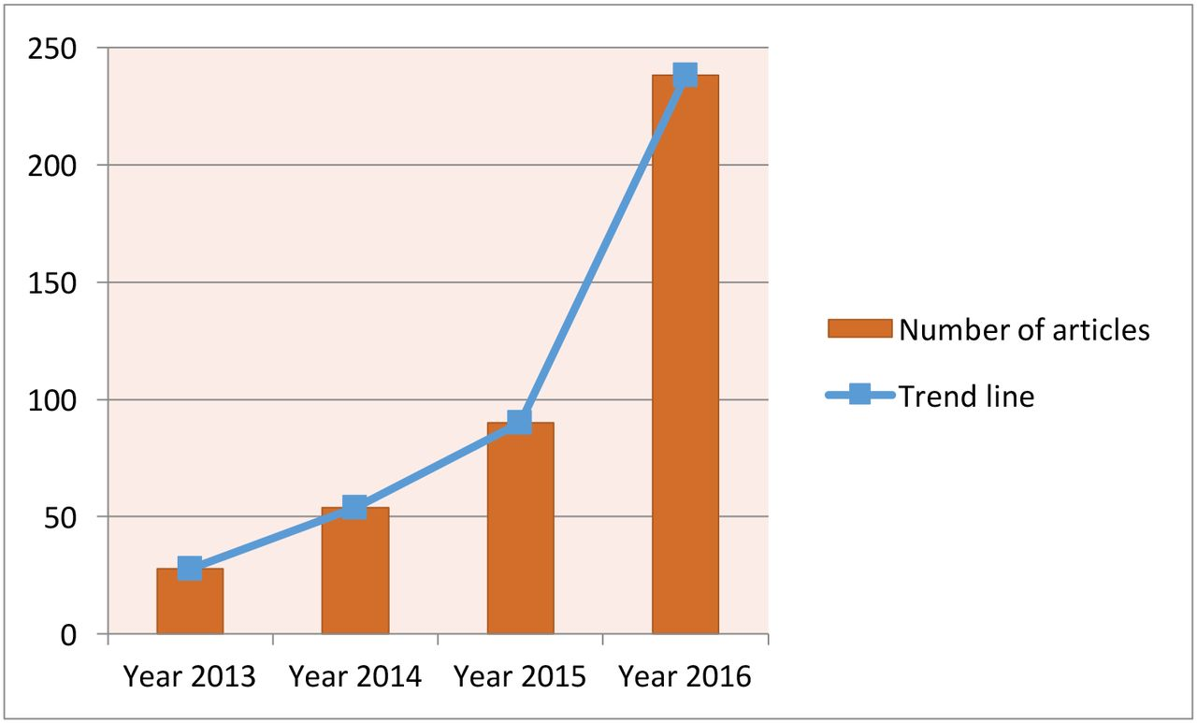
AI for Biomedical Signal/Image Processing 2019
Current trend for deep learning. The data are generated through searching the deep learning in healthcare and disease category on PubMed.
Jiang F, Jiang Y, Zhi H, et al
Artificial intelligence in healthcare: past, present and future
Stroke and Vascular Neurology 2017;2:doi:10.1136/svn-2017-000101

Slide 5
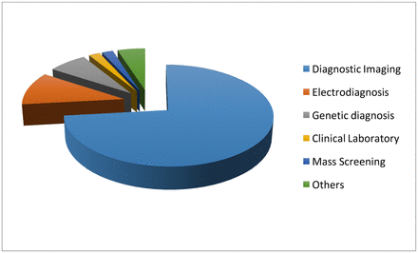
AI for Biomedical Signal/Image Processing 2019
The data sources for deep learning. The data are generated through searching deep learning in combination with the diagnosis techniques on PubMed.
Jiang F, Jiang Y, Zhi H, et al
Artificial intelligence in healthcare: past, present and future
Stroke and Vascular Neurology 2017;2:doi:10.1136/svn-2017-000101

Slide 6
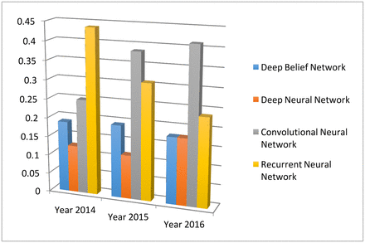
AI for Biomedical Signal/Image Processing 2019
The four main deep learning algorithm and their popularities. The data are generated through searching algorithm names in healthcare and disease category on PubMed.
Jiang F, Jiang Y, Zhi H, et al
Artificial intelligence in healthcare: past, present and future
Stroke and Vascular Neurology 2017;2:doi:10.1136/svn-2017-000101

Slide 7
AI for Biomedical Signal/Image Processing 2019
https://medicalfuturist.com/top-ai-algorithms-healthcare
Does A.I. beat doctors?
Only if you have lived under a rock for the last couple of years could you not have heard about artificial intelligence. Some might have even come across the spread and potential of A.I. in healthcare. Not only smart algorithms themselves but also the hype around A.I. has grown immensely, thus every time a new study about deep learning or machine learning in diagnostics, in medical imaging or any other medical field gets published, newsreaders can be sure that some titles will say that “A.I. has again beaten doctors in field X”.

Slide 8
AI for Biomedical Signal/Image Processing 2019
https://medicalfuturist.com/top-ai-algorithms-healthcare
Does A.I. beat doctors?
Artificial Intelligence is either presented as the ultimate evil destroying mankind – both Elon Musk and Stephen Hawking warned about that – or the only source of the future prosperity of humanity

Slide 9
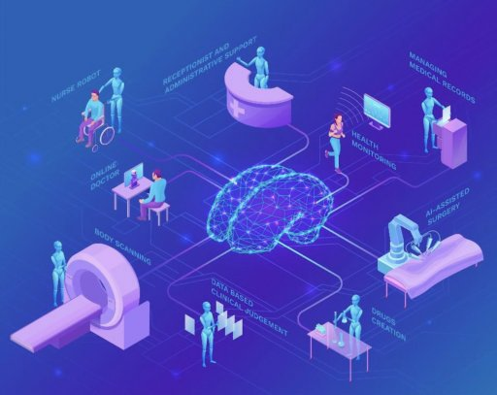
AI for Biomedical Signal/Image Processing 2019
https://medicalfuturist.com/top-ai-algorithms-healthcare
Does A.I. beat doctors?

Slide 10
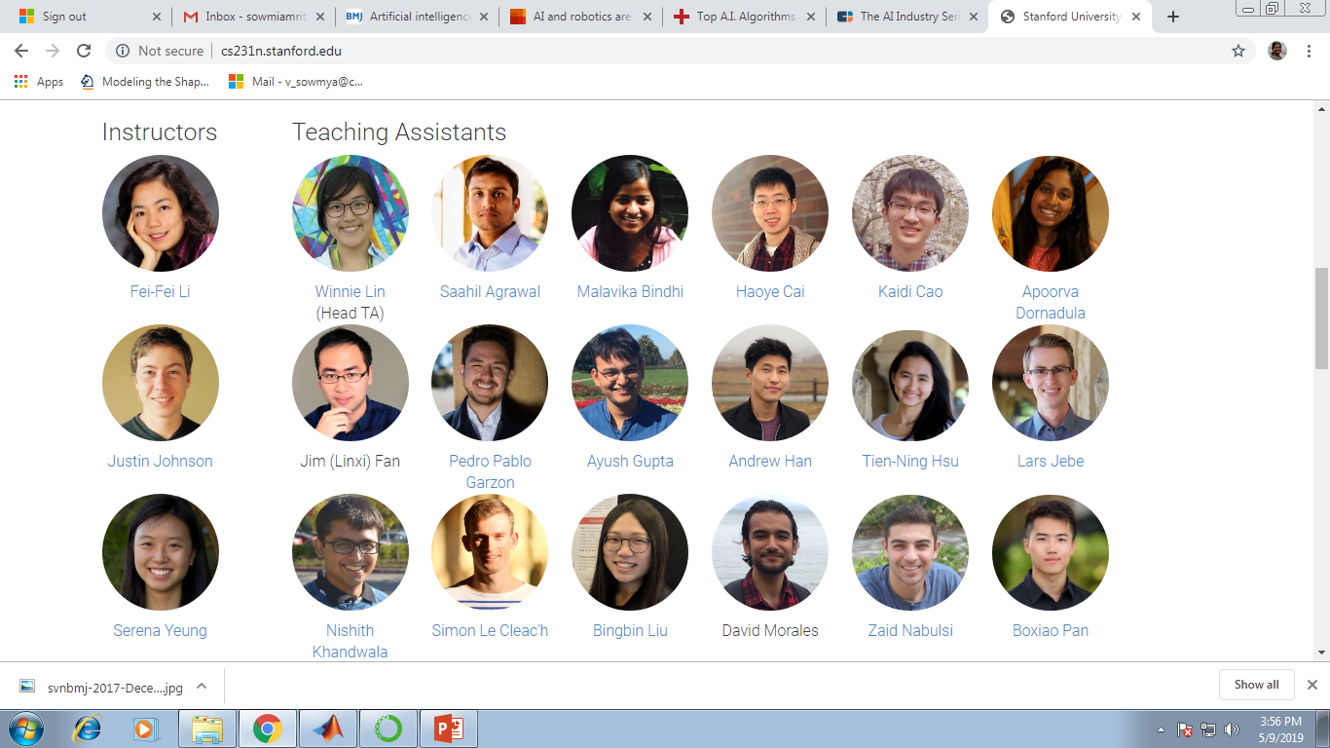
AI for Biomedical Signal/Image Processing 2019
http://cs231n.stanford.edu/
Convolutional Neural Networks for Visual Recognition from 2017-18 (Odd semester)

Slide 11
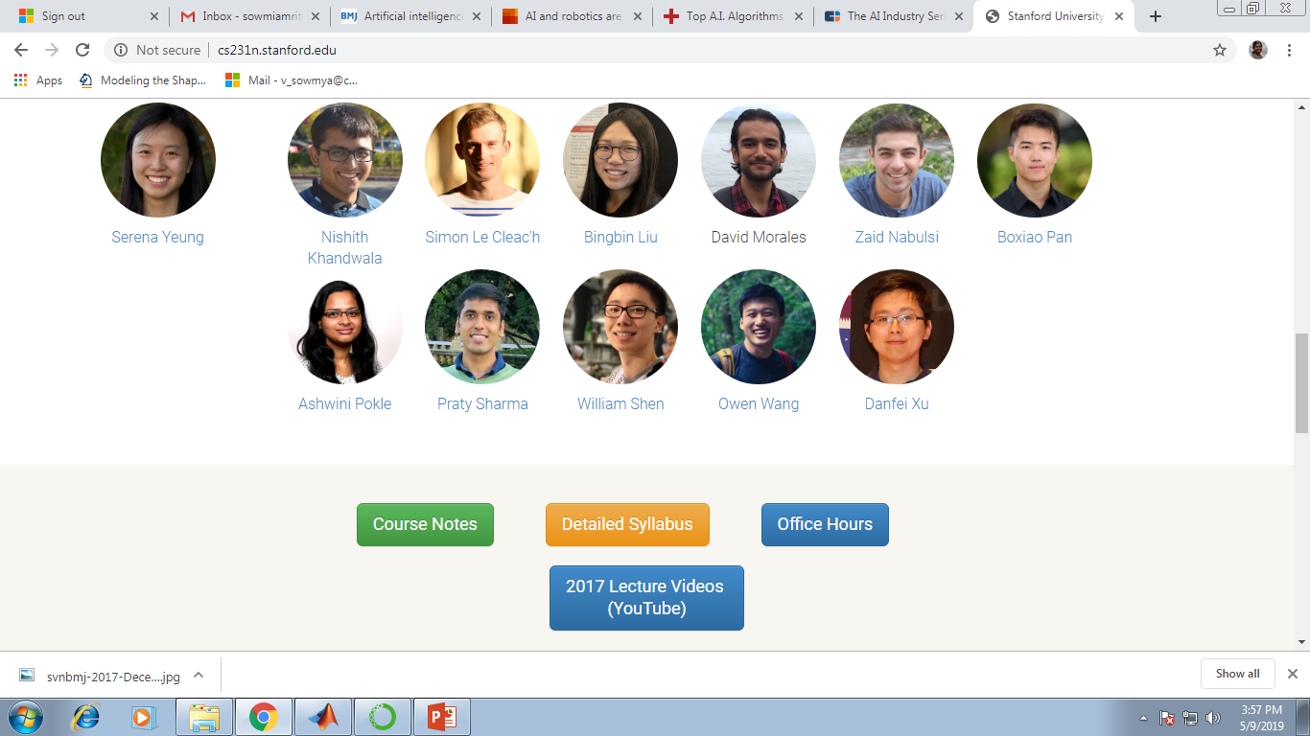
AI for Biomedical Signal/Image Processing 2019
http://cs231n.stanford.edu/
Convolutional Neural Networks for Visual Recognition from 2017-18 (Odd semester)

Slide 12
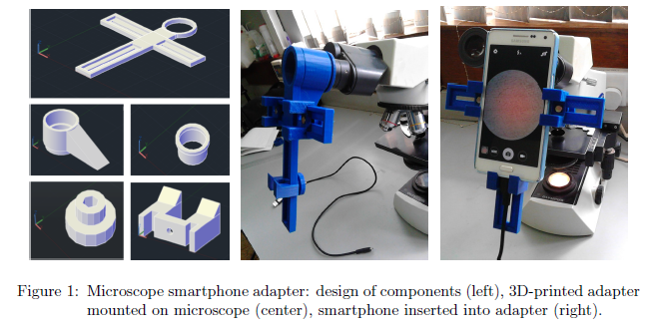
AI for Biomedical Signal/Image Processing 2019
HARDWARE DESIGN
Hardware Design
DEEP CNN FOR MICROSCOPY BASED POINT OF CARE DIAGNOSTICS – John A. Quinn et al., ICMLHC, 2016.

Slide 13
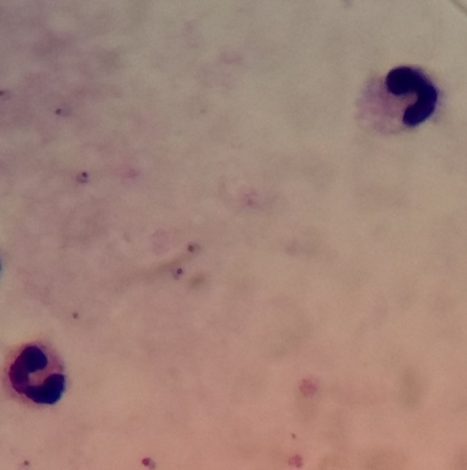
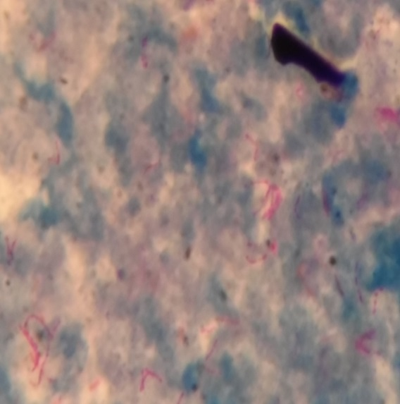
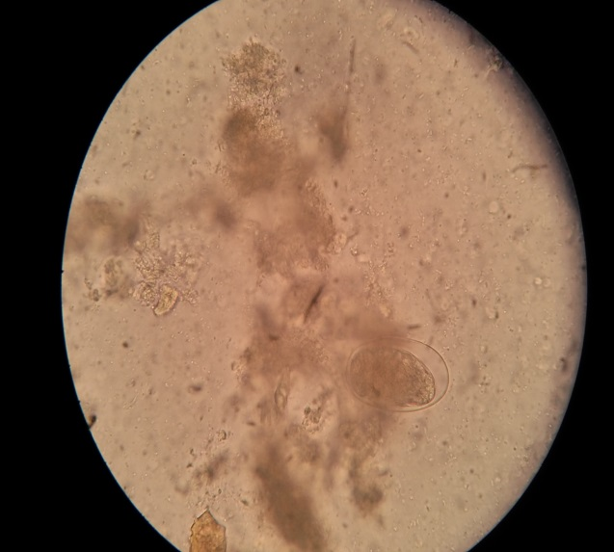
AI for Biomedical Signal/Image Processing 2019
DATASET
Malaria (ML)
Tuberculosis (TB)
Intestinal parasites (IP)
7245 patches in 1182 images
3734 patches in 928 images
162 patches in 1217 images
DEEP CNN FOR MICROSCOPY BASED POINT OF CARE DIAGNOSTICS – John A. Quinn et al., ICMLHC, 2016.

Slide 14
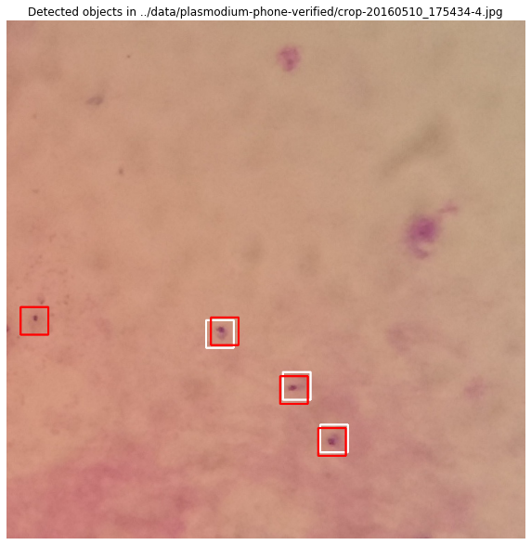
AI for Biomedical Signal/Image Processing 2019
Sample Result-Malaria
White box- labelled by an expert
Red box- Detected by the machine
DEEP CNN FOR MICROSCOPY BASED POINT OF CARE DIAGNOSTICS – John A. Quinn et al. ICMLHC, 2016.

Slide 15
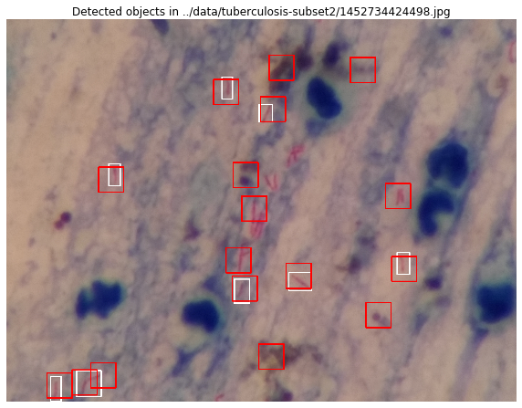
AI for Biomedical Signal/Image Processing 2019
Sample Result-Tuberculosis
White box- labelled by an expert
Red box- Detected by the machine
DEEP CNN FOR MICROSCOPY BASED POINT OF CARE DIAGNOSTICS – John A. Quinn et al. ICMLHC, 2016.

Slide 16
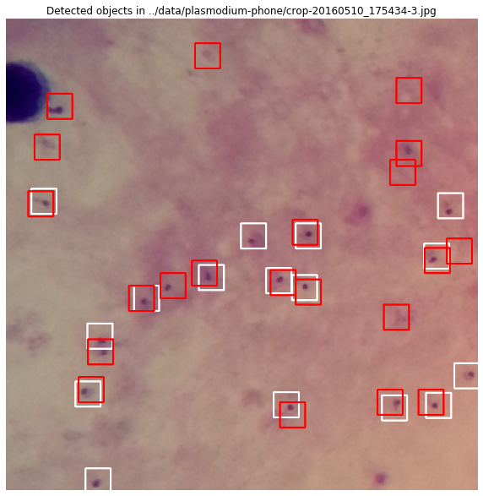
AI for Biomedical Signal/Image Processing 2019
Sample Result-Intestinal Parasites
White box- labelled by an expert
Red box- Detected by the machine
DEEP CNN FOR MICROSCOPY BASED POINT OF CARE DIAGNOSTICS – John A. Quinn et al. ICMLHC, 2016.

Slide 17
AI for Biomedical Signal/Image Processing 2019
Interesting Result-Intestinal
Parasites
DEEP CNN FOR MICROSCOPY BASED POINT OF CARE DIAGNOSTICS – John A. Quinn et al. ICMLHC, 2016.

Slide 18
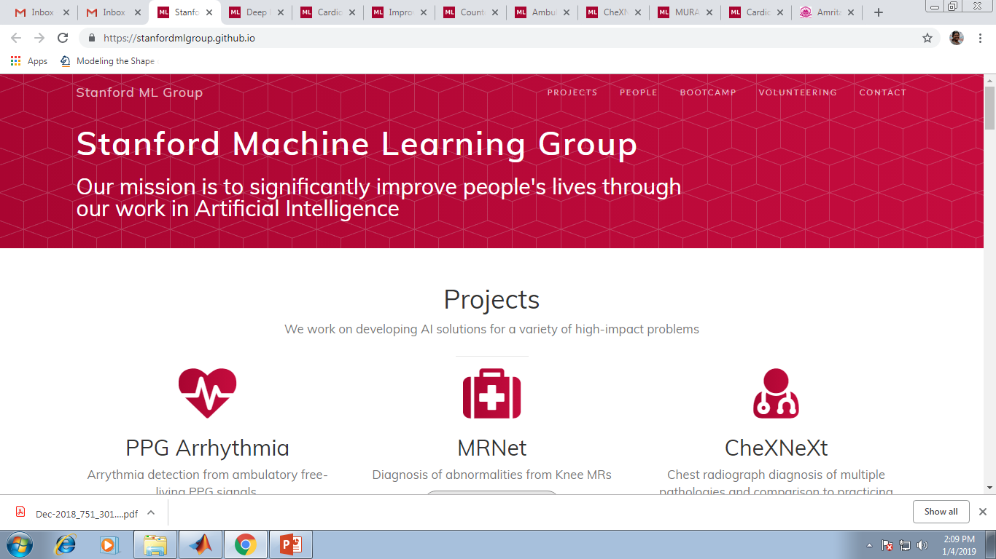
AI for Biomedical Signal/Image Processing 2019
https://stanfordmlgroup.github.io/

Slide 19
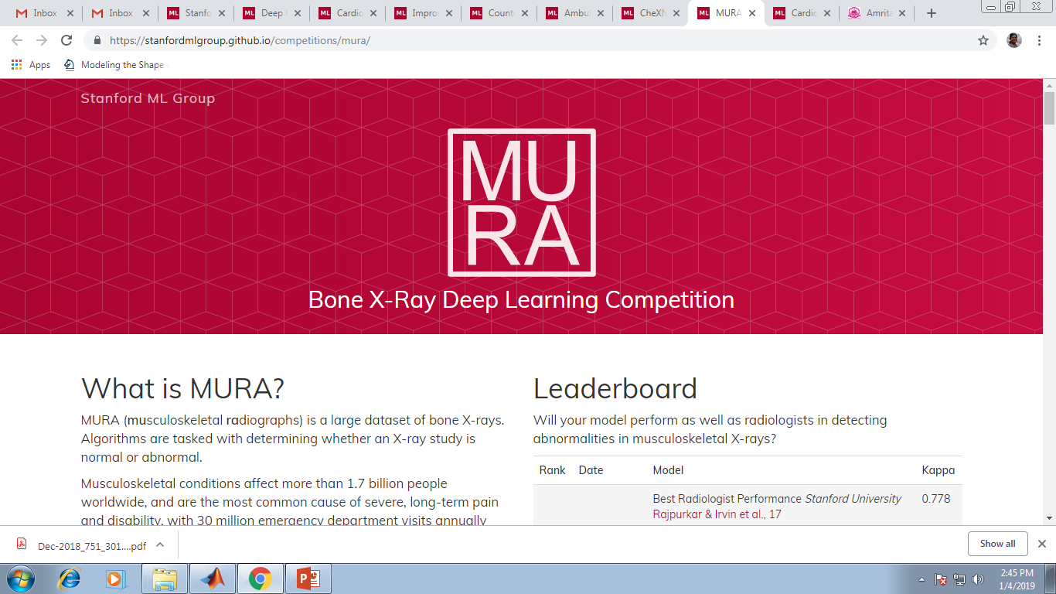
AI for Biomedical Signal/Image Processing 2019
https://stanfordmlgroup.github.io/projects/mura/

Slide 20
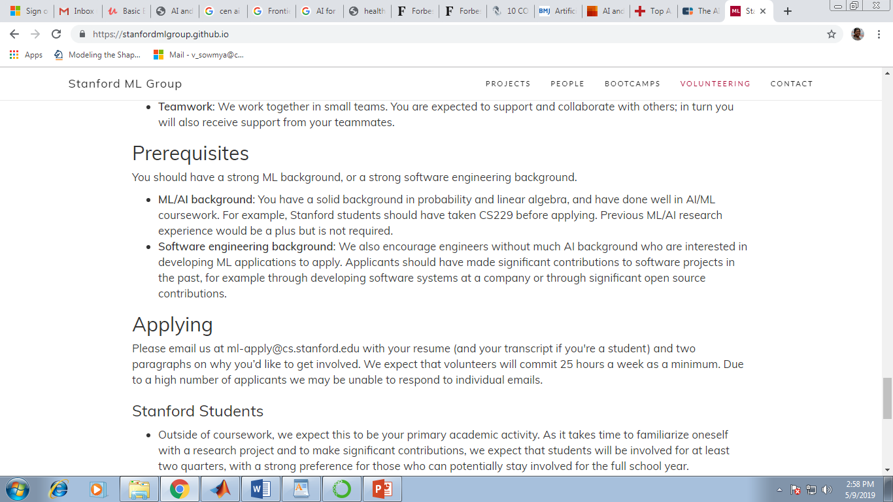
AI for Biomedical Signal/Image Processing 2019
https://stanfordmlgroup.github.io

Slide 21
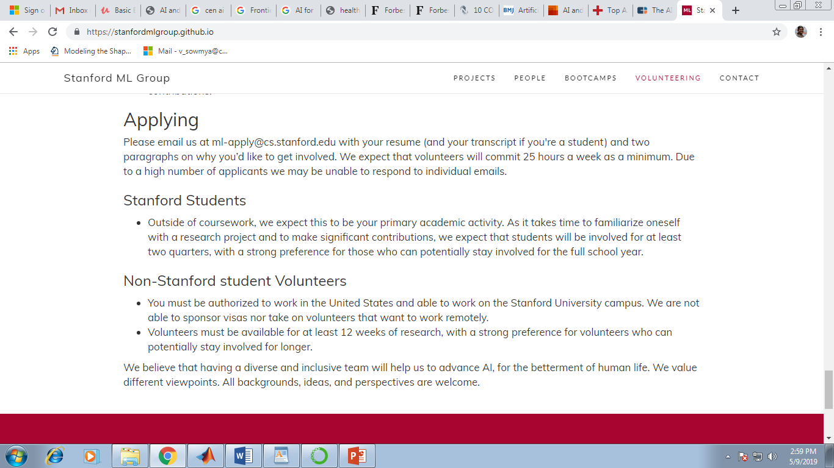
AI for Biomedical Signal/Image Processing 2019
https://stanfordmlgroup.github.io

Slide 22
AI for Biomedical Signal/Image Processing 2019
Classification of normal/abnormal heart sound recordings.
https://physionet.org/physiobank/database/
MIT-BIH Arrhythmia Database
https://physionet.org/physiobank/database/mitdb/
Ptbdb myocardial infarction dataset
https://physionet.org/physiobank/database/ptbdb/
Atrial Fibrillation database
https://physionet.org/challenge/2017/
Peterjenbly database
http://www.peterjbentley.com/heartchallenge/
Sleep Apnea database
https://physionet.org/physiobank/database/apnea-ecg/
Scientific Challenge database
https://www.icbhi2019.com/call-for-sc

Slide 23
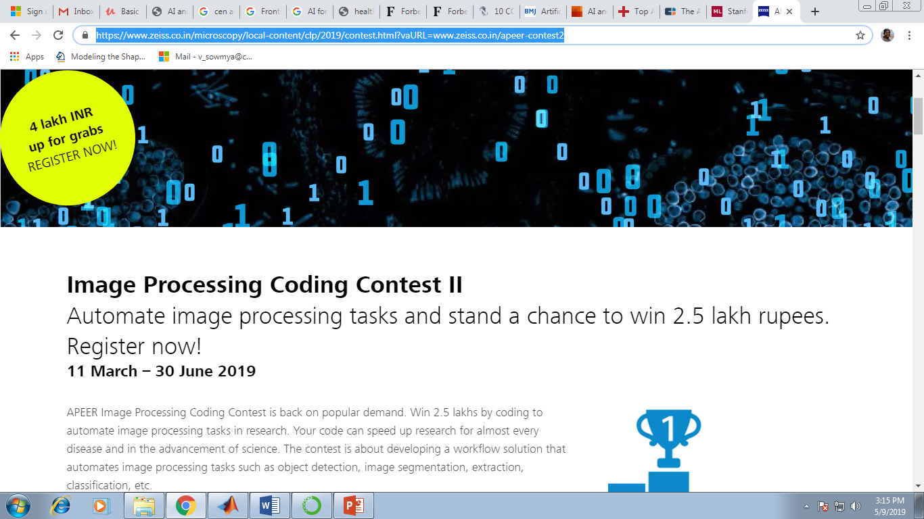
AI for Biomedical Signal/Image Processing 2019
https://www.zeiss.co.in/microscopy/local-content/clp/2019/contest.html?vaURL=www.zeiss.co.in/apeer-contest2

Slide 24
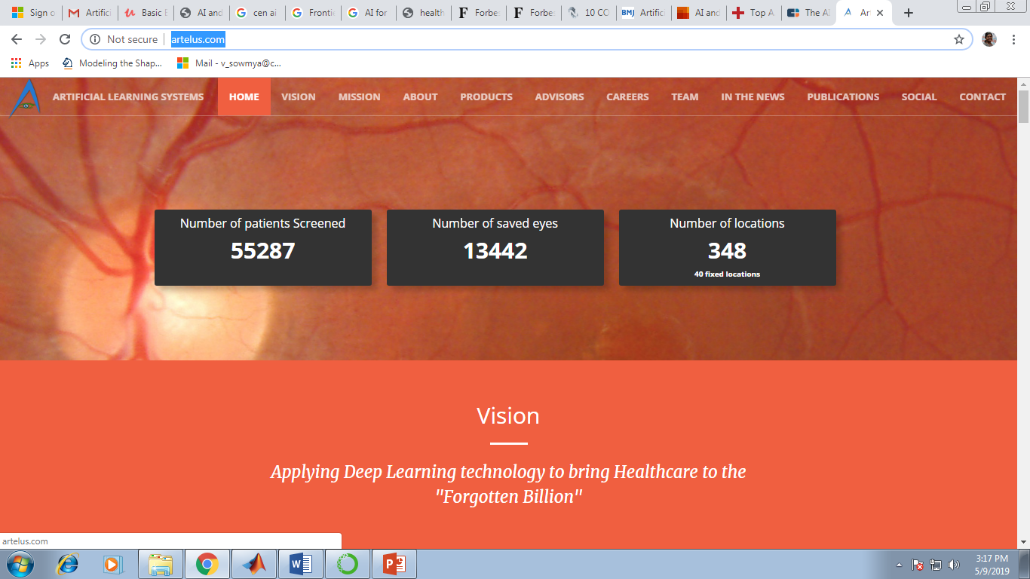
AI for Biomedical Signal/Image Processing 2019
http://artelus.com/

Slide 25
AI for Biomedical Signal/Image Processing 2019
INVITED BOOK CHAPTERS: “Deep Learning for Data Analytics: Foundations, Biomedical Applications and Challenges” to be published by Elsevier.
M.Tech-CEN-(2019-2021)
1. Gopika.P, Krishnendu.C.S, Hari Chandana.M, Ananthakrishnan.S, Sowmya.V*, Gopalakrishnan.E.A, Soman.K.P ‘Single Layer Convolution Neural Network for Cardiac
Disease Classification using Electrocardiogram Signals”.
2. Harini. N, Ramji. B, Sriram. S, Sowmya V*, Soman. K. P., “Musculoskeletal Radiographs Classification Using Deep Learning”.
M.Tech-CEN-(2018-2020)
Gopika.P*, Sowmya.V, Gopalakrishnan.E.A, Soman.K.P, “Transferable Approach For Cardiac Disease Classification Using Deep Learning” : Deep Learning for biomedical and health informatics -BHI-2019 to be published by Elsevier.
Rohit Erai, Sowmya.V, Soman.K.P, “Convolutional Neural Networks for Placenta Cell Classification”. IEEE Conference (Under Review).

Slide 26
AI for Biomedical Signal/Image Processing 2019
1. Anson Simon, R. Vinayakumar, V. Sowmya, K. P. Soman, E. A. Gopalakrishnan, “A Deep Learning Approach for Patch Based Disease Diagnosis from Microscopic Images”, - Classification Techniques for Medical Image Analysis and Computer Aided Design, Elsevier (Science Direct). (Book Chapter), 2019.
2. P. Gopika , V. Sowmya, E. A. Gopalakrishnan, K. P. Soman, “Performance Improvement of Residual Skip Convolutional Neural Network for Myocardial Disease Classification” , Springer International Conference on Intelligent Computing and Communication Technologies (ICICCT) 2019, Hyderabad.
3. Vimal Kurup , V. Sowmya, K. P. Soman, “Effect of Data Pre-Processing on Brain Tumor
Classification Using Capsulenet” , Springer International Conference on Intelligent Computing and Communication Technologies (ICICCT) 2019, Hyderabad.
4. Anupama.M, V. Sowmya, K. P. Soman, “Breast Cancer Classification Using Capsulenet with pre-processed histology images” , IEEE International Conference on Communication and Signal Processing (ICCSP), 2019.

Slide 27
AI for Biomedical Signal/Image Processing 2019
5. Anson Simon, R. Vinayakumar, V. Sowmya, K. P. Soman, “Shallow CNN with LSTM layer for Tuberculosis Detection In Microscopic Images”, -International Journal of Recent Technology and Engineering (TM) | IJRTE | ISSN: 2277-3878 (Online), Volume-7 Issue-6S3, April 2019.
6. Naren Babu, Sai Prasath, Vinayakumar, V. Sowmya, K. P. Soman, “Performance Comparison of Machine Learning Algorithms for Malaria Detection Using Microscopic Images ”, - Research Conference on Data & Decision Science – RCDDS’18, held at SRM University, Chennai.
7. Mohammed Harun, Sai Bhanuja, Vinayakumar, V. Sowmya, K. P. Soman, “Deep Neural Network for Phonocardiogram Signal Classification”, - Research Conference on Data & Decision Science – RCDDS’18, held at SRM University, Chennai.
8. Pathinarupothi. R. K, Vinaykumar. R, Rangan. E, Gopalakrishnan. E.A and Soman. K. P, "Instantaneous heart rate as a robust feature for sleep apnea severity detection using deep learning" - IEEE EMBS International Conference on Biomedical and Health Informatics, BHI 2017, pp. 293-296.

Slide 28
AI for Biomedical Signal/Image Processing 2019
9. Pathinarupothi. R. K, Vinaykumar. R, Rangan. E, Gopalakrishnan. E.A and Soman. K. P, "Single Sensor Techniques for Sleep Apnea Diagnosis Using Deep Learning" - IEEE EMBS International Conference on Biomedical and Health Informatics, BHI 2017, pp. 524-529.
10. Sujadevi. V. G, Soman. K. P, Vinaykumar. R, "Real-Time Detection of Atrial Fibrillation from Short Time Single Lead ECG Traces Using Recurrent Neural Networks"- Springer AISC series proceedings of the International Symposium on Intelligent Systems Technologies and Applications 2017.
11. Sujadevi. V. G, Soman. K. P, Vinaykumar. R Prem Sankar, "Deep models for Phonocardiography (PCG) classification"- IEEE International Conference on Intelligent Communication and Computational Techniques (ICCT), 2017.

Slide 29
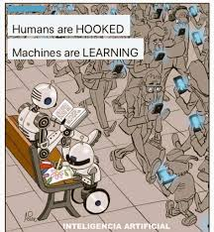
AI for Biomedical Signal/Image Processing 2019

Slide 30
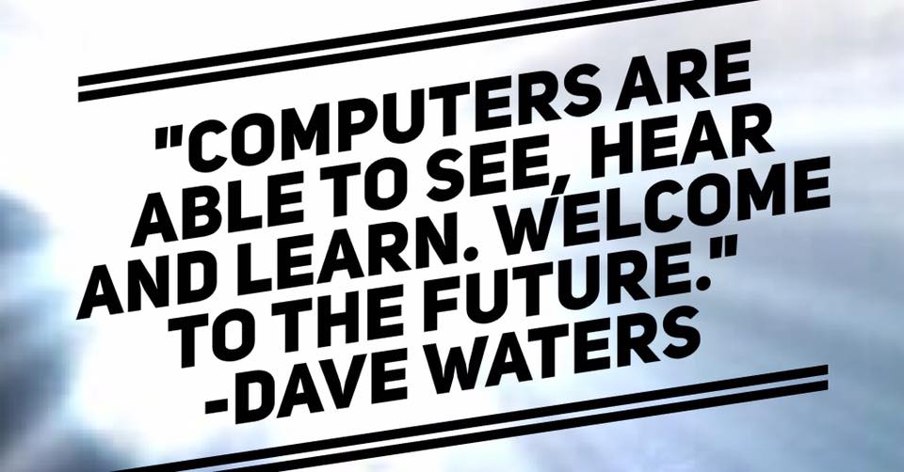
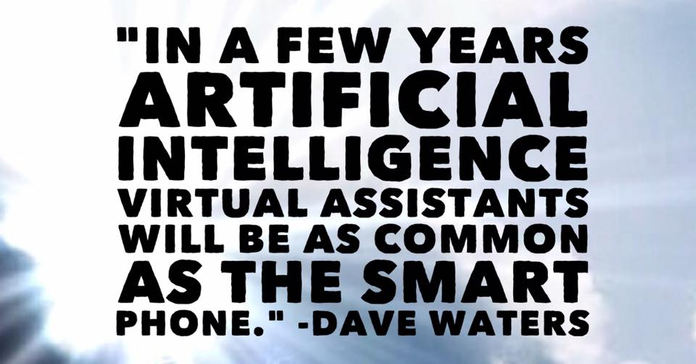
DeepBio 2019

Slide 31
DeepBio 2019
Bill Gates to students – Dec. 2017
“Artificial Intelligence, Energy and Biosciences make good majors ” .

Slide 32
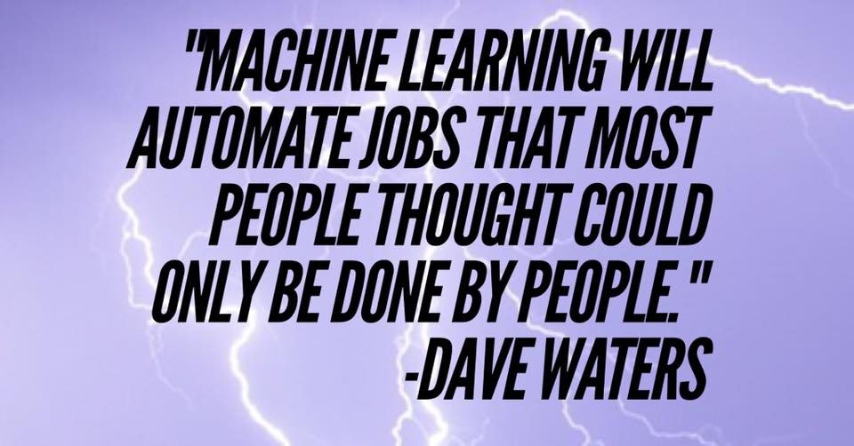
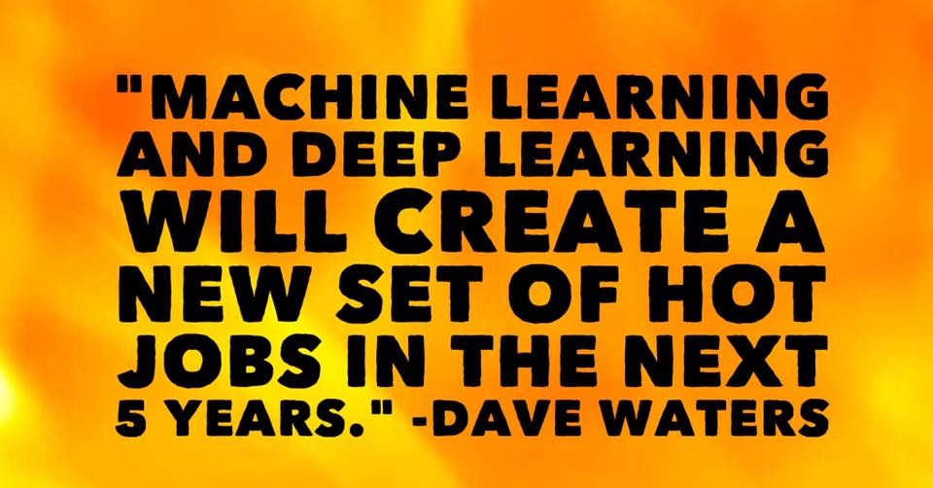

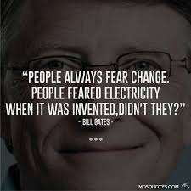
DeepBio 2019

Slide 33
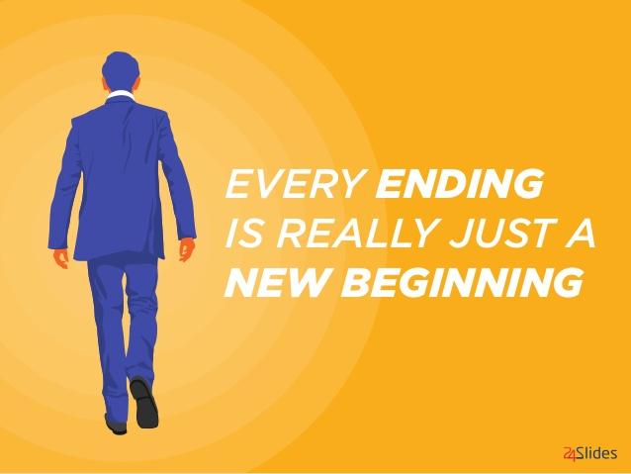

AI for Biomedical Signal/Image Processing 2019

